Slide 1
STUDENT MANAGEMENT SYSTEM
STUDENT NAME : S.MALATHI
REGISTER NO : 312204100
USERNAME : 73D7E42996ABFBDA03D40996EE001058
DEPARTMENT: BACHELOR OF COMMERCE
COLLEGE: SRI RAM COLLEGE OF ARTS AND SCIENCE

Slide 2
STUDENT MANAGEMENT SYSTEM
Index :
Introduction
System analysis
Acknowledgments
Abstract
System Design
References
conclusion

Slide 3
STUDENT MANAGEMENT SYSTEM
Introduction:
Student management refers to the evaluation and assessment of a student's professionalism, participation, literature evaluation, role-play performance, and cumulative essay final examination. s to ancdtive essay final examina•

Slide 4
STUDENT MANAGEMENT SYSTEM
SYSTEM ANALYSIS:
EXISTING SYSTEM :
System Analysis is a detailed study of the various operations performed by a system and their relationships within and outside of the system. Here the key question is what all problems exist in the present system? What must be done to solve the problem? Analysis begins when a user or manager begins a study of the program using existing system.
System analysis can be categorized into four parts
• System planning and initial investigation
•Information Gathering
• Applying analysis tools for structured analysis
. •Feasibility study
• Cost/ Benefit analysis.

Slide 5
STUDENT MANAGEMENT SYSTEM
PROPOSED SYSTEM:
In our proposed system we have the provision for adding the details of the students by the admin. So the details can't be misused. Another advantage of the system is that it is very easy to edit the details of the student and delete a student when it found unnecessary. The marks Our proposed system has several advantages
➤ Fast access to database
➤ Less error
➤ Search facility
➤ Look and Feel Environment

Slide 6
STUDENT MANAGEMENT SYSTEM
System design:
System design is a process through which requirements are translated into a representation of software. Initially the representation depicts a holistic view of software, Subsequent refinement leads to a design representation that is very close to source code. Design is a place where quality fostered in software development. Design provides us with representation of software that can be assessed for quality; this is the only way that can accurately translate the customer requirements into finished software product or system. System design serves as the foundation for all software engineering and software maintenance steps that follow.
We look the design process from three distinct perspectives:
•Conceptual Design
•Logical Design
. •Physical Design

Slide 7
STUDENT MANAGEMENT SYSTEM
Acknowledgement:
The success and eventual result of this project involved a lot of support and help from a lot of individuals, and we are immensely grateful to have accomplished this during the culmination of our project work. Giving us the chance to do this project work and for giving us all the support and advice that made us complete the project on time.

Slide 8
STUDENT MANAGEMENT SYSTEM
ABSTRACT :
Our project explains about the student management. This project mainly explains the various actions related to student details. This project shows some ease in adding, editing and deleting the student details. It also provides a less time consuming process for viewing, adding, editing and deleting the marks of the students
Our project includes
Student Registration
Subject Allocation
Teacher Registration
Adding Remarks
Managing Student details

Slide 9
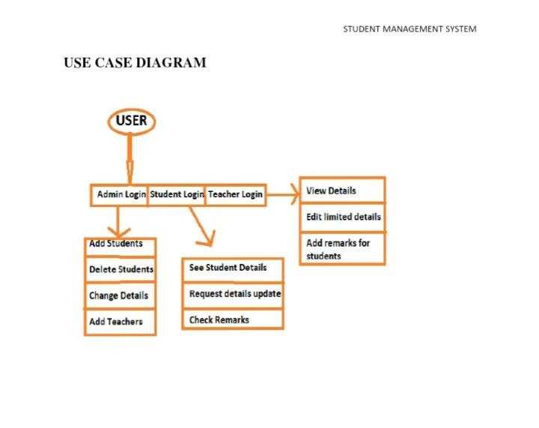
STUDENT MANAGEMENT SYSTEM

Slide 10
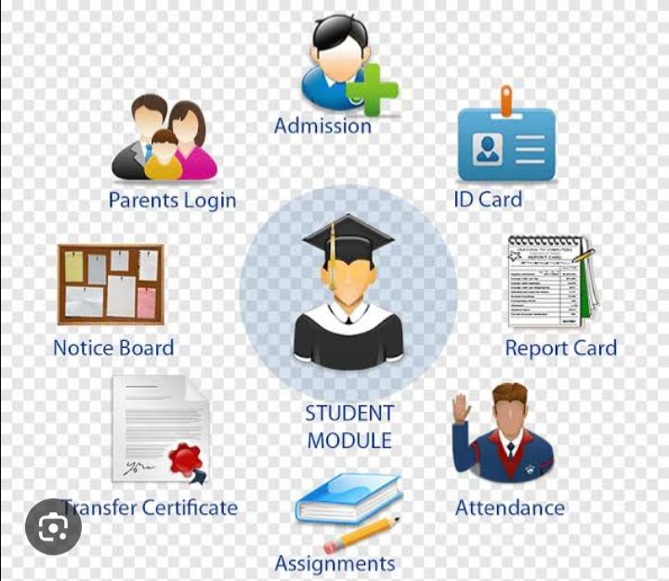
STUDENT MANAGEMENT SYSTEM

Slide 11
STUDENT MANAGEMENT SYSTEM

Slide 12
STUDENT MANAGEMENT SYSTEM
Conclusion :
This project is just a basic user friendly online management system so everyone can have the experience of a management system and get comfortable using basic functions, which will help them using some advanced systems.

